Slide 1
Financial Performance of
Large Budget Films

Slide 2
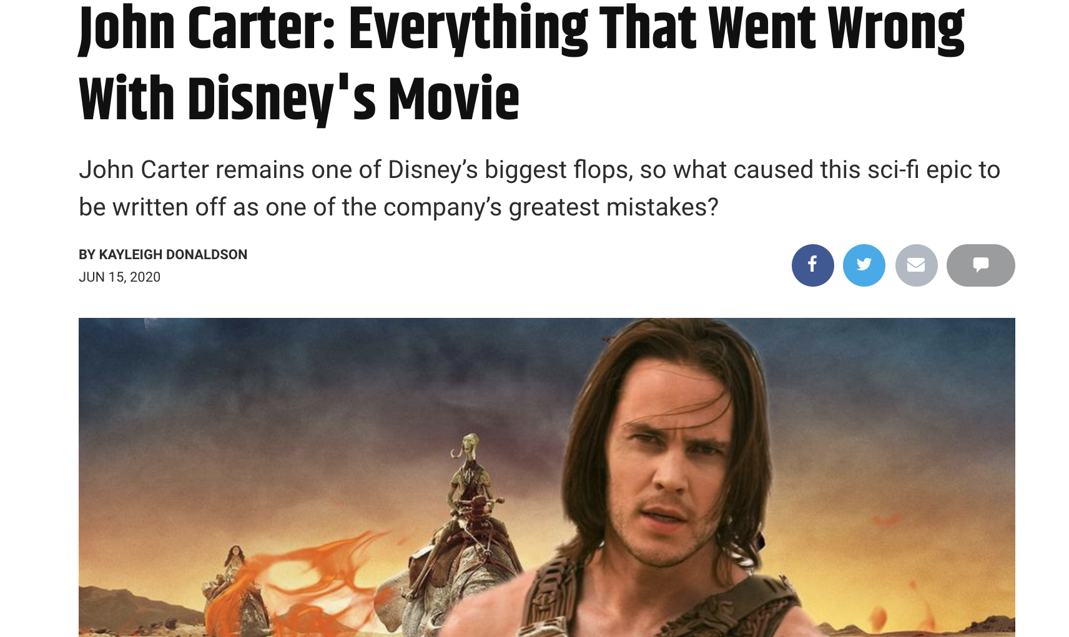
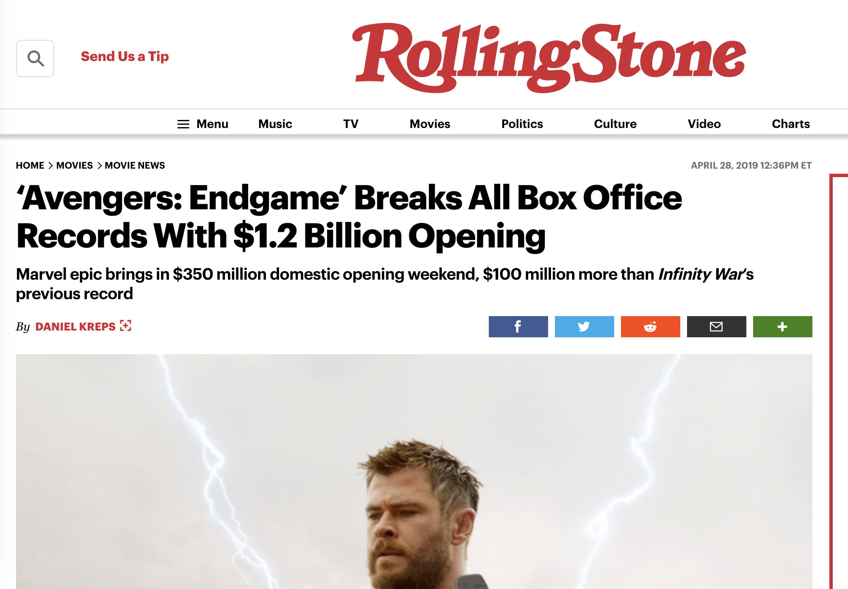
What makes film a success?
Some break record, others flop

Slide 3
HYPOTHESIS ON TOTAL GROSS
POSSIBLE KEY FACTORS
BUDGET
ACTORS
DIRECTOR
TARGET AUDIENCE
GENRE

Slide 4
MODEL DESIGN
WEB SCRAPING
ASSIGNING NUMERIC VALUES
REGRESSION MODEL SELECTION
DATA SORTING
IMDB.COM WATCHMOJO.COM THE-NUMBERS.COM
ACTORS DIRECTORS MPAA RATINGS
ACTOR GROSS DIRECTOR GROSS
LINEAR POLYNOMIAL LASSO RIDGE RANDOM FOREST GRADIENT BOOST
1

Slide 5
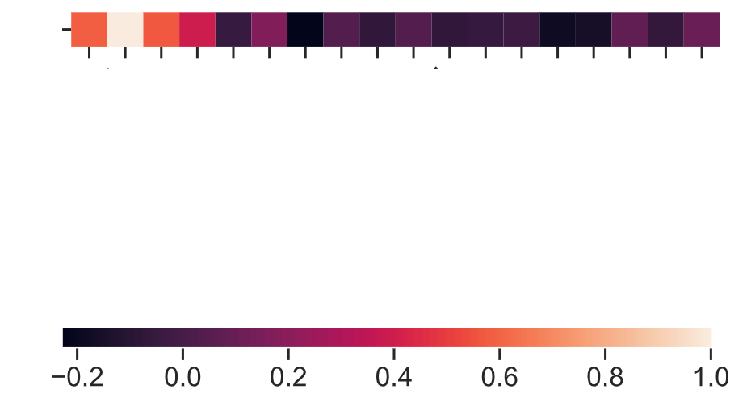
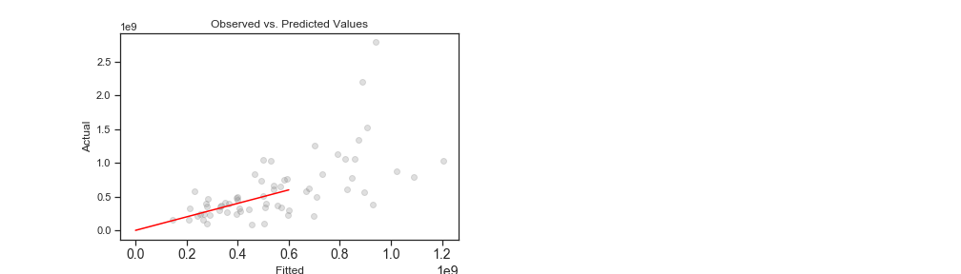
INITIAL RESULTS
R
TOTAL GROSS
PG
G
LINEAR REGRESSION
PG-13
MUSICAL
DRAMA
COMEDY
WESTERN
ACTION
THRILLER
HORROR
ADVENTURE
BUDGET
BLACK COMEDY
ACTOR AVG GROSS
ROMANTIC COMEDY
TOTAL GROSS
DIRECTOR AVG GROSS
CORRELATION GRADIENT

Slide 6
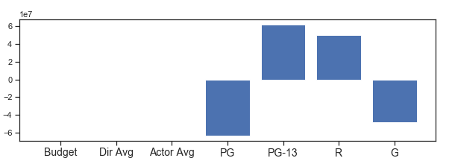
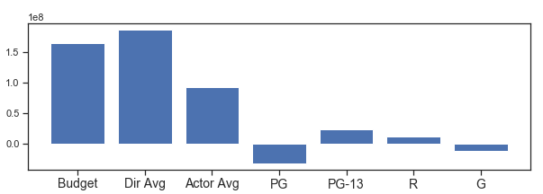
FEATURE COEFFICIENTS
LINEAR MODEL
RIDGE MODEL

Slide 7
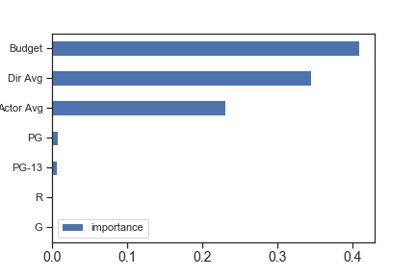
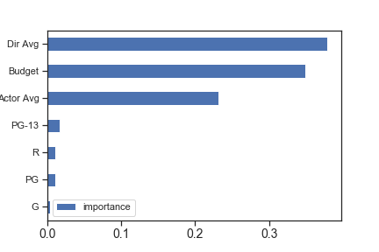
REGRESSION TREE MODELS
GRADIENT BOOST
RANDOM FOREST

Slide 8
FINAL REMARKS
FUTURE MODEL IMPROVEMENTS:
SUPPORT ACTORS
PRODUCERS
FILMING STUDIO
FRANCHISE

Slide 9

THANKS!
Any questions?
Project GitHub repo:
git@github.com:RamonMartin1/REGRESSION_MODELS.git
Email for additional information at:
martin.ramon.f@gmail.com

